Slide 1
Divide and Conquer Select, Multiplication
CS240 Spring 2023
Rui Fan

Slide 2
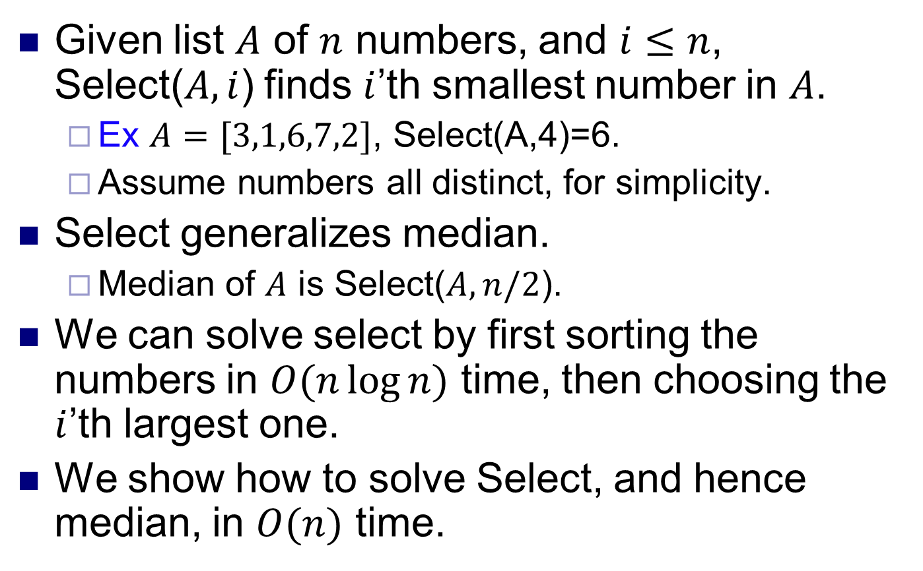
Selection
Given list $A$ of $n$ numbers, and $i≤n$, Select($A,i$) finds $i$’th smallest number in $A$.
Ex $A=[3,1,6,7,2]$, Select(A,4)=6.
Assume numbers all distinct, for simplicity.
Select generalizes median.
Median of $A$ is Select($A, n/2$).
We can solve select by first sorting the numbers in $O(n\log{n)}$ time, then choosing the $i$’th largest one.
We show how to solve Select, and hence median, in $O(n)$ time.

Slide 3
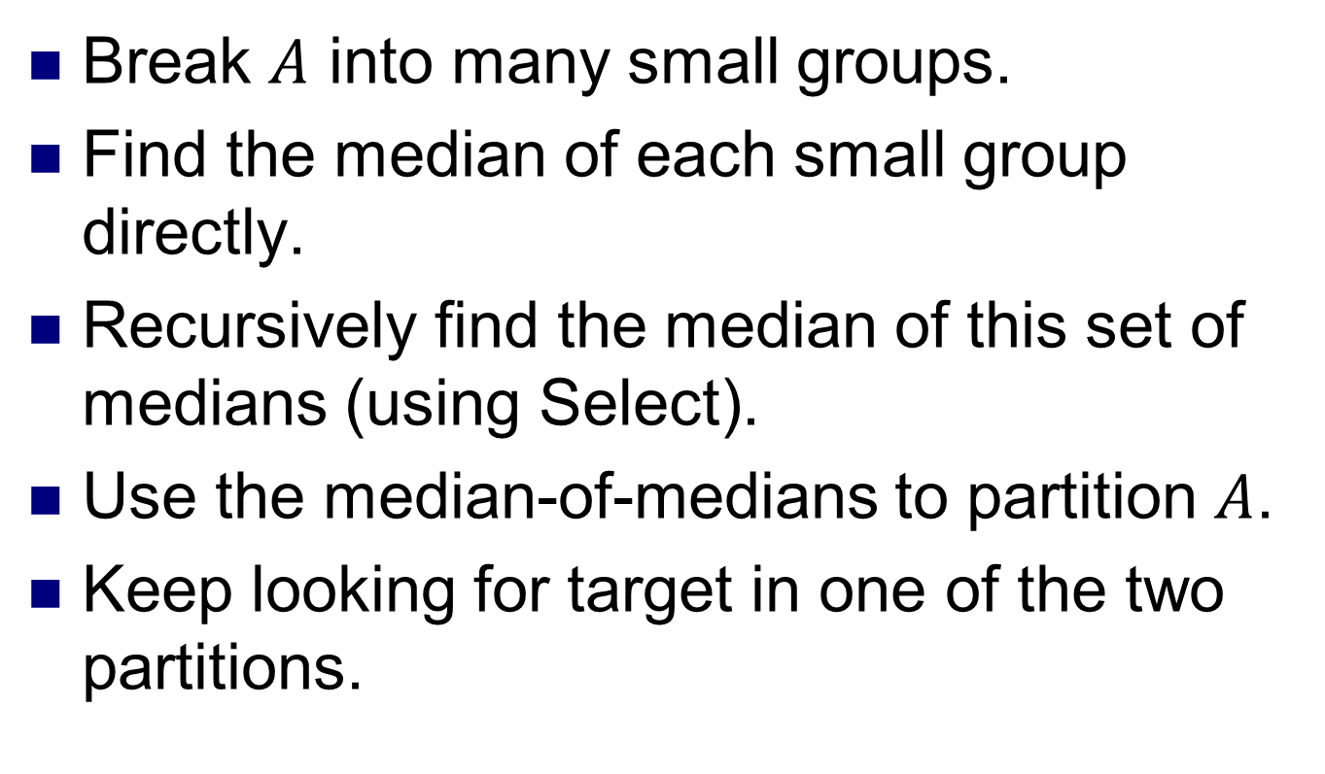
Select algorithm overview
Break $A$ into many small groups.
Find the median of each small group directly.
Recursively find the median of this set of medians (using Select).
Use the median-of-medians to partition $A$.
Keep looking for target in one of the two partitions.

Slide 4
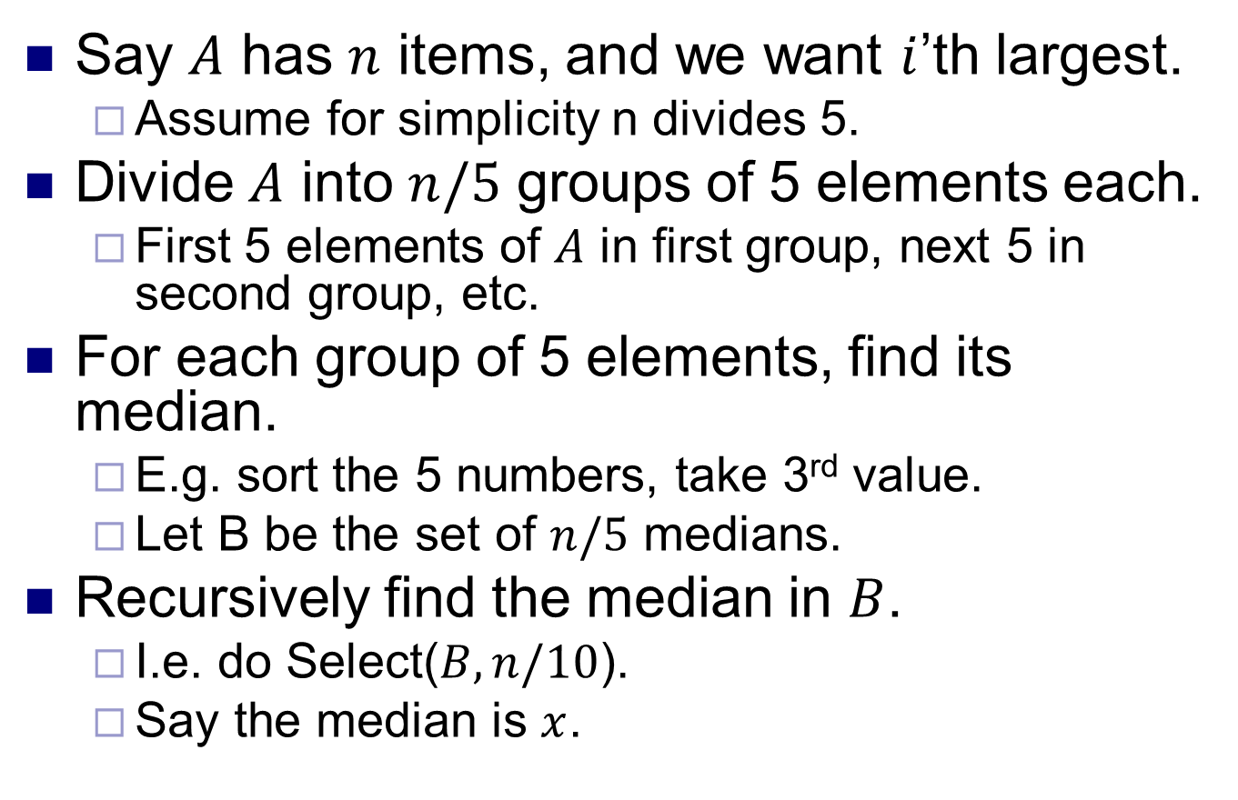
Select algorithm 1
Say $A$ has $n$ items, and we want $i$’th largest.
Assume for simplicity n divides 5.
Divide $A$ into $n/5$ groups of 5 elements each.
First 5 elements of $A$ in first group, next 5 in second group, etc.
For each group of 5 elements, find its median.
E.g. sort the 5 numbers, take 3rd value.
Let B be the set of $n/5$ medians.
Recursively find the median in $B$.
I.e. do Select($B,n/10$).
Say the median is $x$.

Slide 5
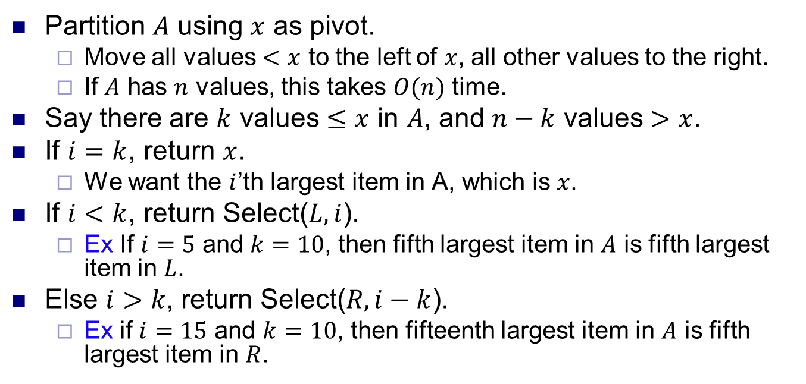
Select algorithm 2
A
k-1 values < x
x
n-k values > x
L
R
Partition $A$ using $x$ as pivot.
Move all values $<x$ to the left of $x$, all other values to the right.
If $A$ has $n$ values, this takes $O(n)$ time.
Say there are $k$ values $≤x$ in $A$, and $n−k$ values $>x$.
If $i=k$, return $x$.
We want the $i$’th largest item in A, which is $x$.
If $i<k$, return Select($L,i$).
Ex If $i=5$ and $k=10$, then fifth largest item in $A$ is fifth largest item in $L$.
Else $i>k$, return Select($R,i−k$).
Ex if $i=15$ and $k=10$, then fifteenth largest item in $A$ is fifth largest item in $R$.

Slide 6
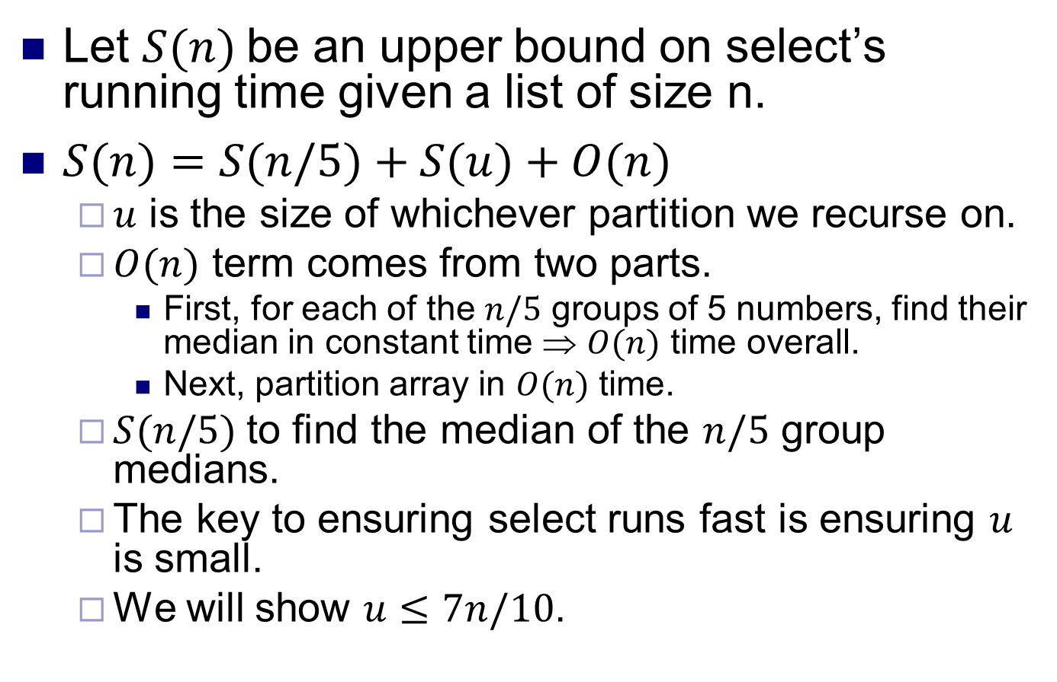
Select analysis 1
Let $S(n)$be an upper bound on select’s running time given a list of size n.
$S(n)=S(n/5)+S(u)+O(n)$
$u$ is the size of whichever partition we recurse on.
$O(n)$ term comes from two parts.
First, for each of the $n/5$ groups of 5 numbers, find their median in constant time ⇒ $O(n)$ time overall.
Next, partition array in $O(n)$ time.
$S(n/5)$to find the median of the $n/5$ group medians.
The key to ensuring select runs fast is ensuring $u$ is small.
We will show $u≤7n/10$.

Slide 7
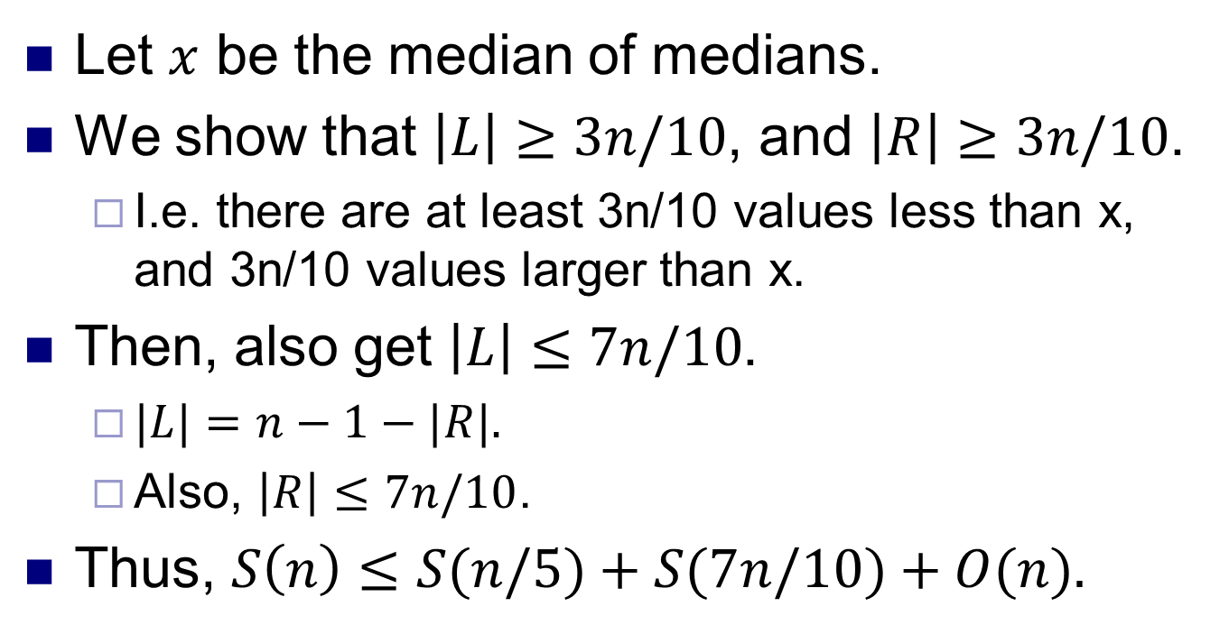
Select analysis 2
A
L = {values < x}
x
R = {values > x}
Let $x$ be the median of medians.
We show that $\left|L\right|≥3n/10$, and $\left|R\right|≥3n/10$.
I.e. there are at least 3n/10 values less than x, and 3n/10 values larger than x.
Then, also get $\left|L\right|≤7n/10$.
$|L|=n−1−|R|.$
Also, $\left|R\right|≤7n/10$.
Thus, $S\left(n\right)≤S(n/5)+S(7n/10)+O(n).$

Slide 8
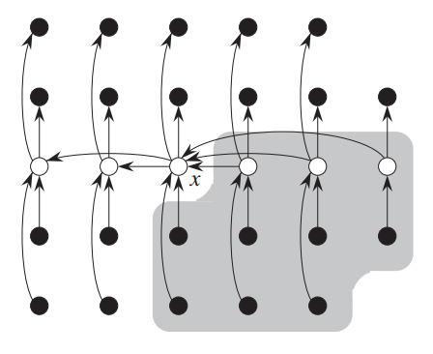
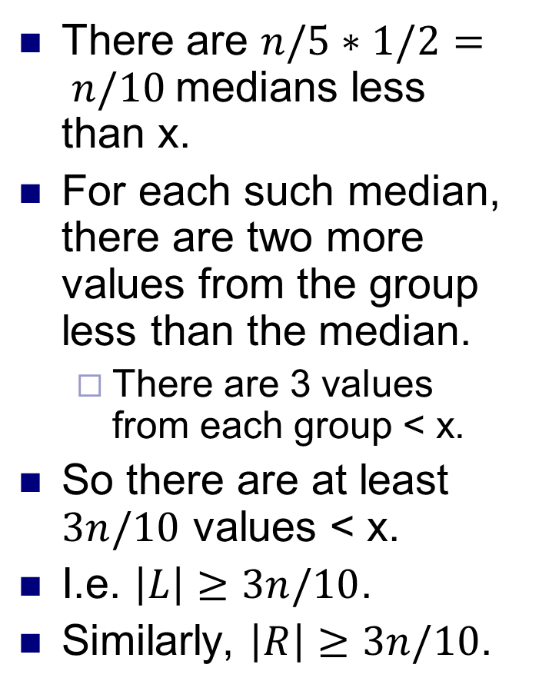
Select analysis 3
There are $n/5∗1/2= n/10$medians less than x.
For each such median, there are two more values from the group less than the median.
There are 3 values from each group < x.
So there are at least $3n/10$ values < x.
I.e. $\left|L\right|≥3n/10$.
Similarly, $\left|R\right|≥3n/10$.
Groups of 5 elements are shown in columns.
Medians are shown in white.
Medians less than x are shown to the right.
Source: Introduction to Algorithms
Cormen, Leiserson, Rivest, Stein

Slide 9
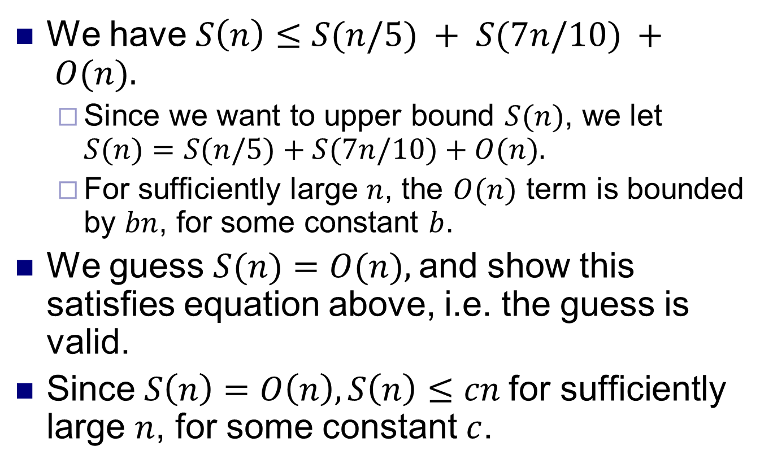
Select analysis 4
We have $S\left(n\right)≤S(n/5) + S(7n/10) + O(n).$
Since we want to upper bound $S(n)$, we let $S(n)=S(n/5)+S(7n/10)+O(n).$
For sufficiently large $n$, the $O(n)$ term is bounded by $bn$, for some constant $b$.
We guess $S(n)=O(n),$and show this satisfies equation above, i.e. the guess is valid.
Since $S\left(n\right)=O\left(n\right), S\left(n\right)≤cn$for sufficiently large $n$, for some constant $c$.

Slide 10
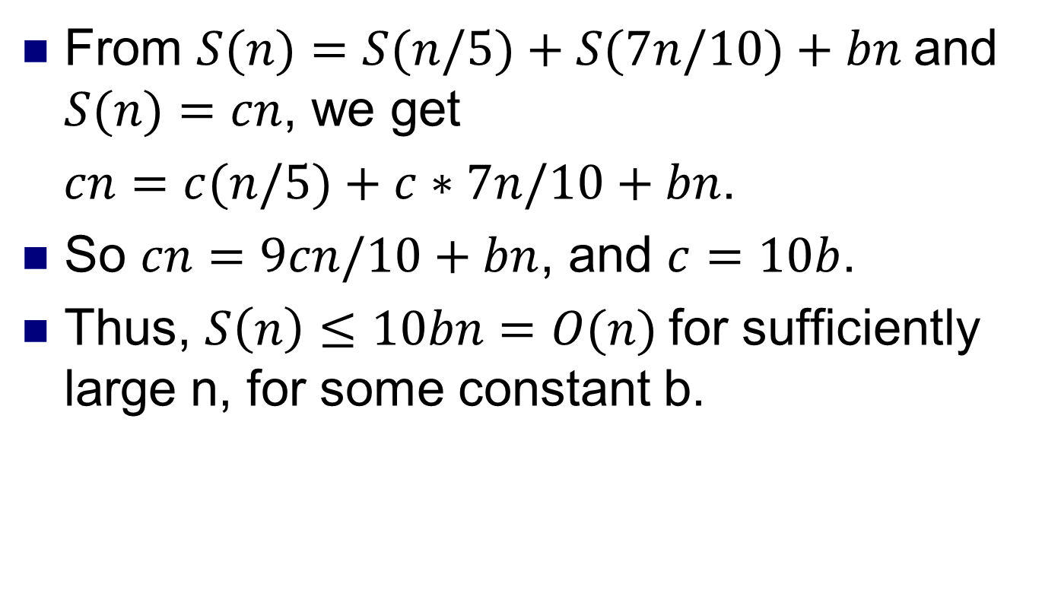
Select analysis 5
From $S(n)=S(n/5)+S(7n/10)+bn$and $S(n)=cn$, we get
$cn=c(n/5)+c∗7n/10+bn$.
So $cn=9cn/10+bn$, and $c=10b$.
Thus, $S\left(n\right)≤10bn=O(n)$for sufficiently large n, for some constant b.

Slide 11
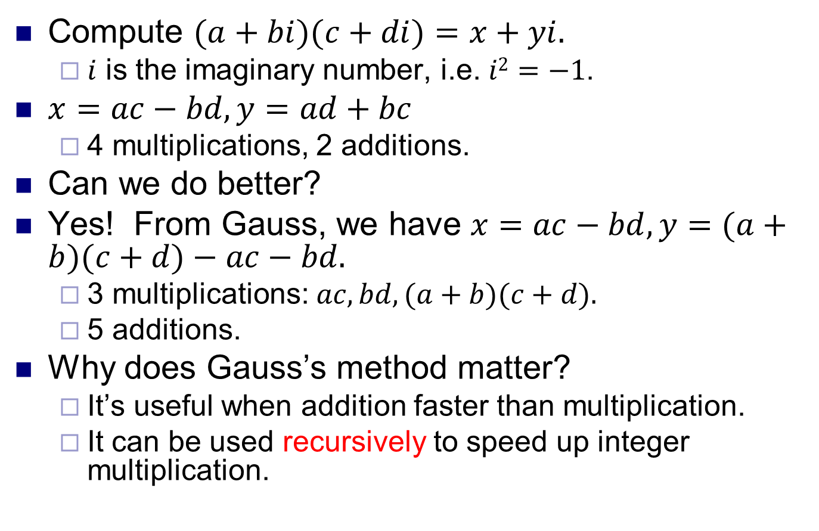
Multiplying complex numbers
Compute $(a+bi)(c+di)=x+yi.$
$i$ is the imaginary number, i.e. $i2=−1$.
$x=ac−bd, y=ad+bc$
4 multiplications, 2 additions.
Can we do better?
Yes! From Gauss, we have $x=ac−bd, y=(a+b)(c+d)−ac−bd.$
3 multiplications: $ac, bd, (a+b)(c+d).$
5 additions.
Why does Gauss’s method matter?
It’s useful when addition faster than multiplication.
It can be used recursively to speed up integer multiplication.

Slide 12
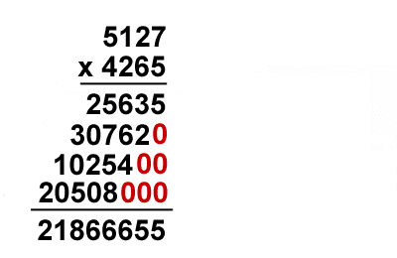
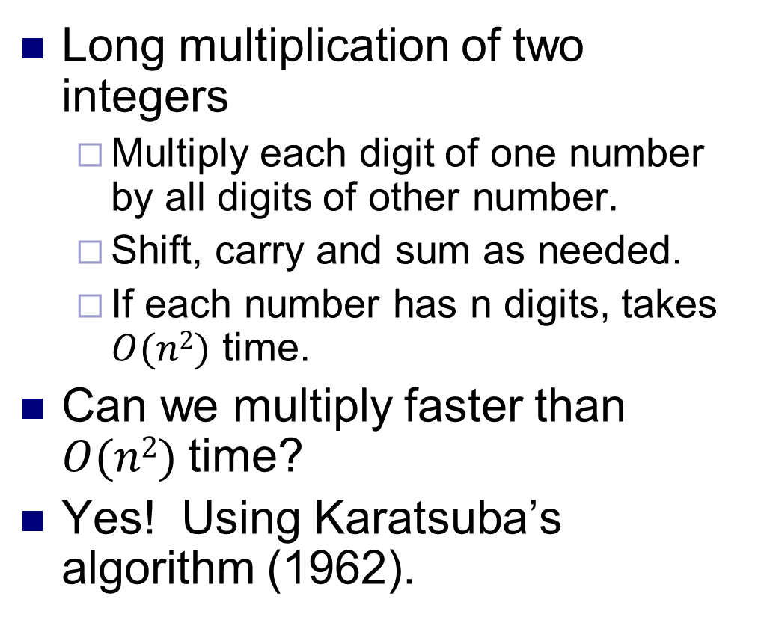
Complexity of multiplication
Long multiplication of two integers
Multiply each digit of one number by all digits of other number.
Shift, carry and sum as needed.
If each number has n digits, takes $O(n2)$ time.
Can we multiply faster than $O(n2)$time?
Yes! Using Karatsuba’s algorithm (1962).

Slide 13
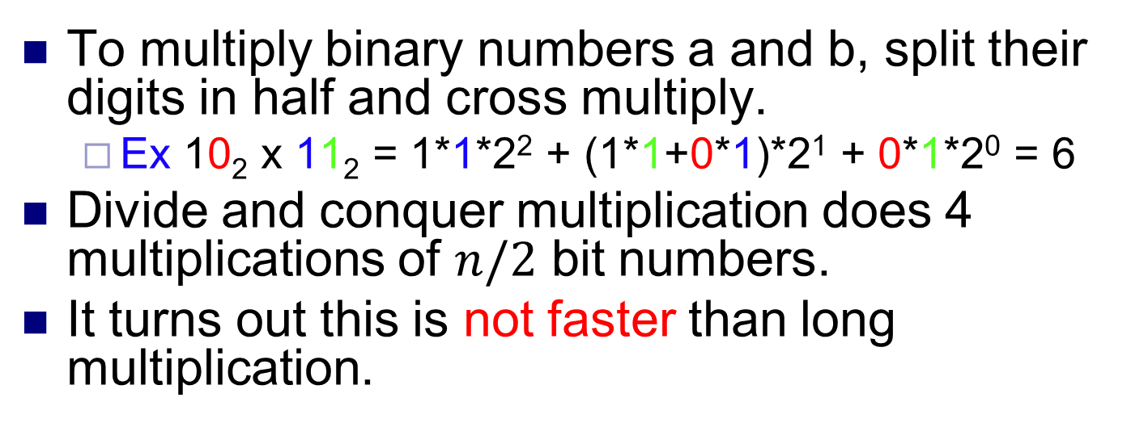
Divide and conquer multiplication
a = 10001101 b = 11100001
a₁
a₀
b₁
b₀
To multiply binary numbers a and b, split their digits in half and cross multiply.
Ex 10₂ x 11₂ = 1*1*2² + (1*1+0*1)*2¹ + 0*1*2⁰ = 6
Divide and conquer multiplication does 4 multiplications of $n/2$ bit numbers.
It turns out this is not faster than long multiplication.

Slide 14
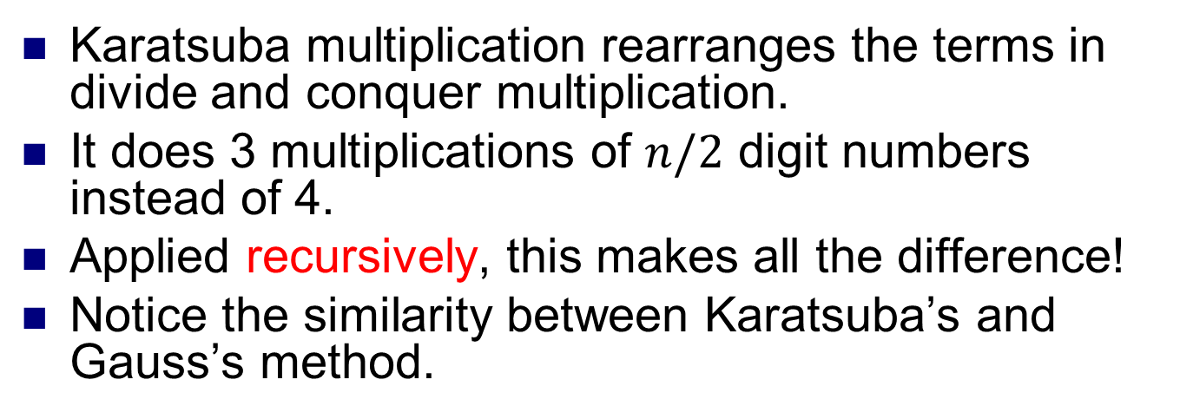
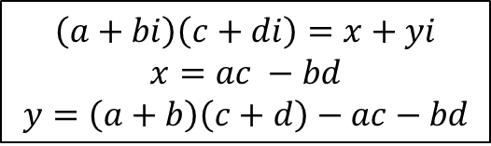
Karatsuba multiplication
a = 10001101 b = 11100001
$$\left(a+bi\right)\left(c+di\right)=x+yi$$
$$x=ac −bd$$
$$y=\left(a+b\right)\left(c+d\right)−ac−bd$$
a₁
a₀
b₁
b₀
Karatsuba multiplication rearranges the terms in divide and conquer multiplication.
It does 3 multiplications of $n/2$ digit numbers instead of 4.
Applied recursively, this makes all the difference!
Notice the similarity between Karatsuba’s and Gauss’s method.

Slide 15
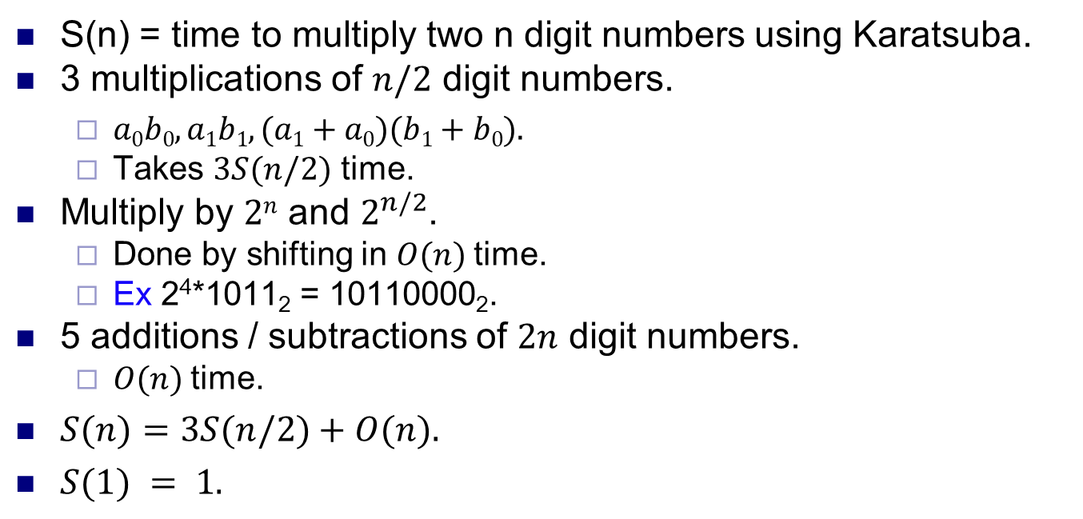
Karatsuba complexity
S(n) = time to multiply two n digit numbers using Karatsuba.
3 multiplications of $n/2$ digit numbers.
$a0b0, a1b1, (a1+a0)(b1+b0).$
Takes $3S(n/2)$ time.
Multiply by $2n$ and $2^{n/2}$.
Done by shifting in $O(n)$time.
Ex 2⁴*1011₂ = 10110000₂.
5 additions / subtractions of $2n$ digit numbers.
$O(n)$time.
$S(n)=3S(n/2)+O(n).$
$S(1) = 1.$

Slide 16
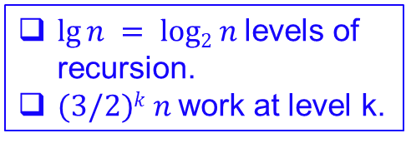
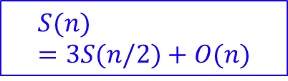
Karatsuba recursion tree
$$S(n)=3S(n/2)+O(n)$$
$lg⁡n = log2 n$levels of recursion.
$(3/2)k n$work at level k.
T(n)
n
T(n/2)
T(n/2)
T(n/2)
3(n/2)
T(n/4)
T(n/4)
T(n/4)
T(n/4)
T(n/4)
T(n/4)
T(n/4)
T(n/4)
T(n/4)
9(n/4)
...
...
T(n / 2^{k})
3^{k} (n / 2^{k})
...
...
T(1)
T(1)
T(1)
T(1)
...
T(1)
T(1)
T(1)
T(1)
3 ^{lg n} (1)
Source: http://www.cs.bu.edu/fac/byers/ courses/330/S13/handouts/05multiply.ppt

Slide 17
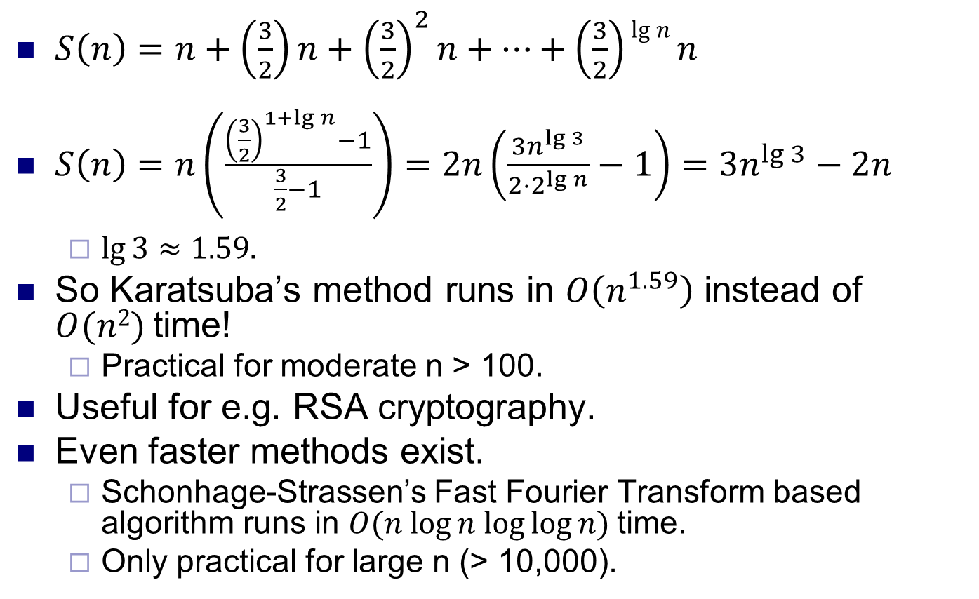
Karatsuba complexity
$S\left(n\right)=n+\left(\frac{3}{2}\right)n+{\left(\frac{3}{2}\right)}^{2}n+…+\left(\frac{3}{2}\right)\lg{n}n$
$S\left(n\right)=n\left(\frac{{\left(\frac{3}{2}\right)}^{1+\lg{n}}−1}{\frac{3}{2}−1}\right)=2n\left(\frac{3n^{\lg{3}}}{2⋅2^{\lg{n}}}−1\right)=3n^{\lg{3}}−2n$
$\lg{3}≈1.59.$
So Karatsuba’s method runs in $O\left(n^{1.59}\right)$ instead of $O(n2)$time!
Practical for moderate n > 100.
Useful for e.g. RSA cryptography.
Even faster methods exist.
Schonhage-Strassen’s Fast Fourier Transform based algorithm runs in $O(n log⁡n log⁡log⁡n)$time.
Only practical for large n (> 10,000).

Slide 18
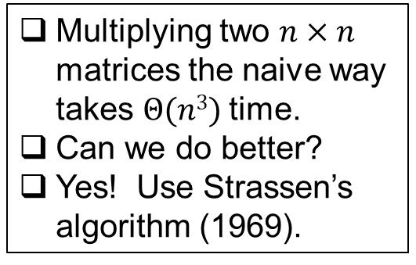
Complexity of matrix multiplication
Source: http://www.cs.bu.edu/ fac/byers/courses/330/S13/handouts/05multiply.ppt
for (i=0; i<n; i++) {
for (j=0; j<n; j++) {
C[i,j] = 0;
for (k=0; k<n; k++)
C[i,j] = C[i,j] + A[i,k]*B[k,j]
Multiplying two $n×n$ matrices the naive way takes $Θ(n3)$time.
Can we do better?
Yes! Use Strassen’s algorithm (1969).

Slide 19
Block matrix multiplication
C₁₁
A₁₁
A₁₂
B₁₁
B₂₁
Break A, B and C into blocks. Multiply them as in normal matrix multiplication.
Each block can be broken into subblocks and multiplied same way.
Leads to recursive matrix multiplication method.

Slide 20
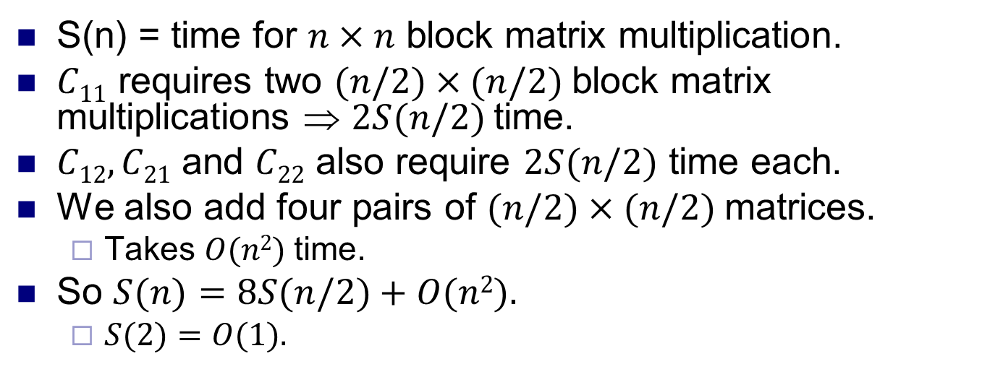
Block matrix multiplication
S(n) = time for $n×n$ block matrix multiplication.
$C11$ requires two $(n/2)×(n/2)$block matrix multiplications ⇒ $2S(n/2)$time.
$C12, C21$ and $C22$ also require $2S(n/2)$ time each.
We also add four pairs of $(n/2)×(n/2)$matrices.
Takes $O(n2)$time.
So $S(n)=8S(n/2)+O(n2).$
$S(2)=O(1).$

Slide 21
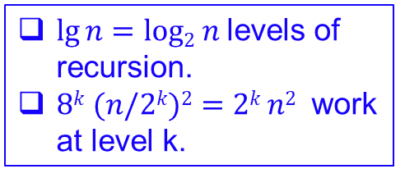
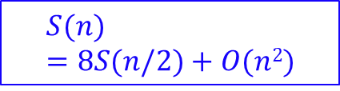
Block MM recursion tree
$$S(n)=8S(n/2)+O(n2)$$
$lg⁡n=log2 n$levels of recursion.
$8k (n/2k)2=2k n2$ work at level k.
T(n)
n²
...
T(n/2)
T(n/2)
8(n/2)²
...
...
T(n/4)
T(n/4)
T(n/4)
T(n/4)
8²(n/4)²
...
...
T(n / 2^{k})
8^{k} (n / 2^{k})²
...
...
...
...
...
T(2)
T(2)
T(2)
T(2)
8 ^{lg n} (1)

Slide 22
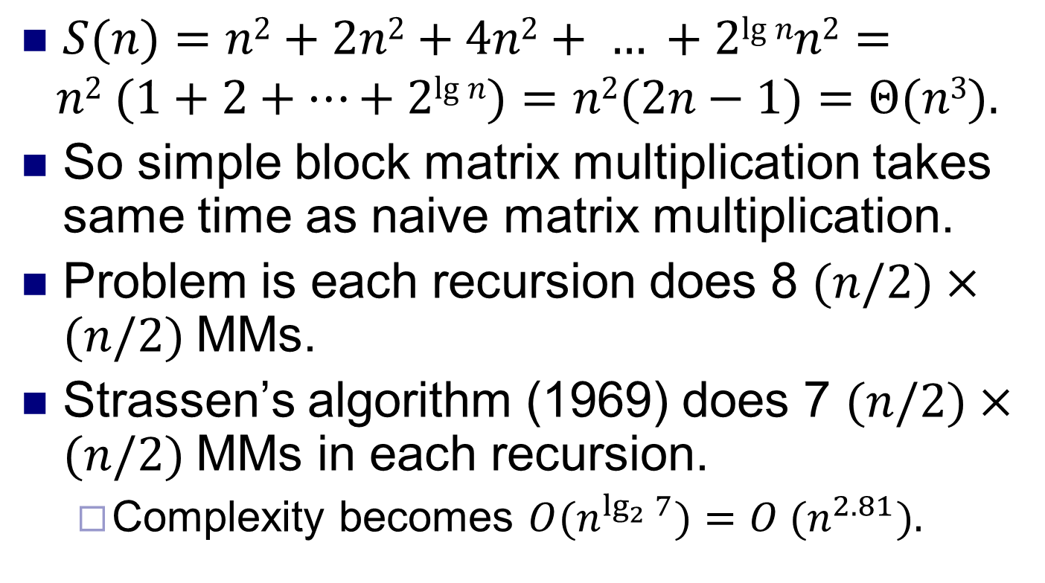
Block MM complexity
$S(n)=n2+2n2+4n2+ … +2lg⁡nn2=$
$$n2 (1+2+…+2lg⁡n)=n2(2n−1)=Θ(n3).$$
So simple block matrix multiplication takes same time as naive matrix multiplication.
Problem is each recursion does 8 $(n/2)×(n/2)$MMs.
Strassen’s algorithm (1969) does 7 $(n/2)×(n/2)$MMs in each recursion.
Complexity becomes $O(n^{\lg_{2}{7}})=O (n^{2.81}).$

Slide 23
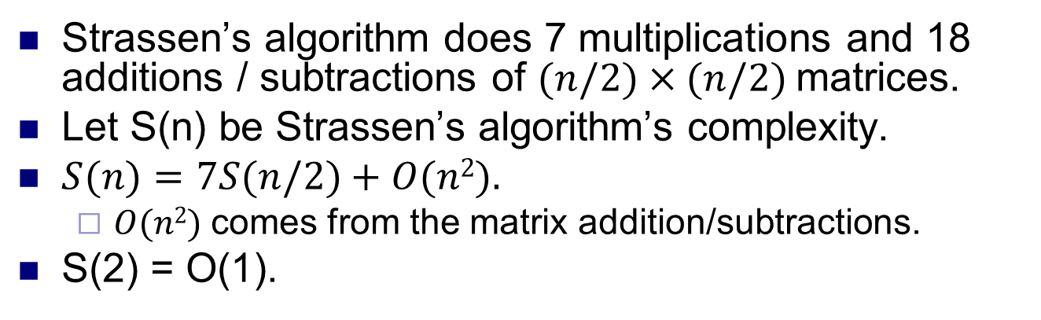
Strassen’s algorithm
Strassen’s algorithm does 7 multiplications and 18 additions / subtractions of $(n/2)×(n/2)$matrices.
Let S(n) be Strassen’s algorithm’s complexity.
$S(n)=7S(n/2)+O(n2).$
$O(n2)$comes from the matrix addition/subtractions.
S(2) = O(1).

Slide 24
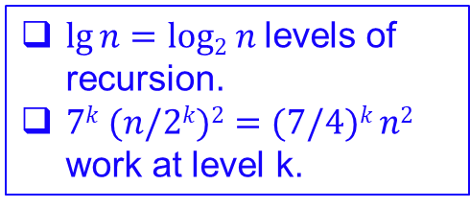

Strassen recursion tree
$lg⁡n=log2 n$levels of recursion.
$7k (n/2k)2=(7/4)k n2$ work at level k.
$$S(n)=7S(n/2)+O(n2)$$
T(n)
n²
...
T(n/2)
T(n/2)
7(n/2)²
...
...
T(n/4)
T(n/4)
T(n/4)
T(n/4)
7²(n/4)²
...
...
T(n / 2^{k})
7^{k} (n / 2^{k})²
...
...
...
...
...
T(2)
T(2)
T(2)
T(2)
7 ^{lg n} (1)

Slide 25
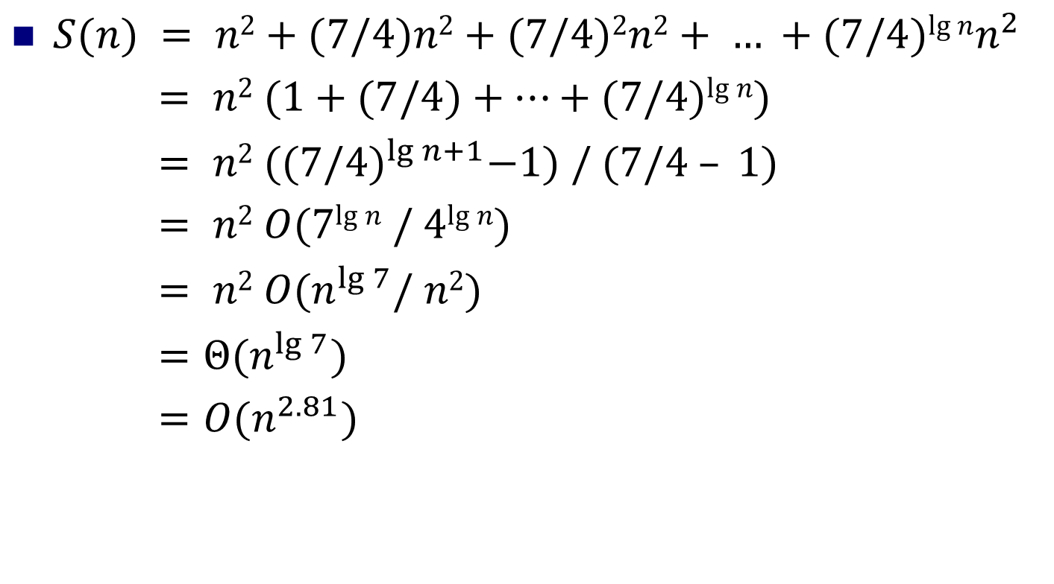
Strassen’s algorithm complexity
$S(n) = n2+(7/4)n2+(7/4)2n2+ … +(7/4)lg⁡nn^{2}$
$= n2 (1+(7/4)+…+(7/4)lg⁡n)$
$= n2 ({(7/4)}^{\lg{n+1}}−1) / (7/4 – 1)$
$= n2 O(7lg⁡n / 4lg⁡n)$
$= n2 O(n^{\lg{7}}/ n2)$
$=Θ(n^{\lg{7}})$
$=O(n^{2.81})$

Slide 26
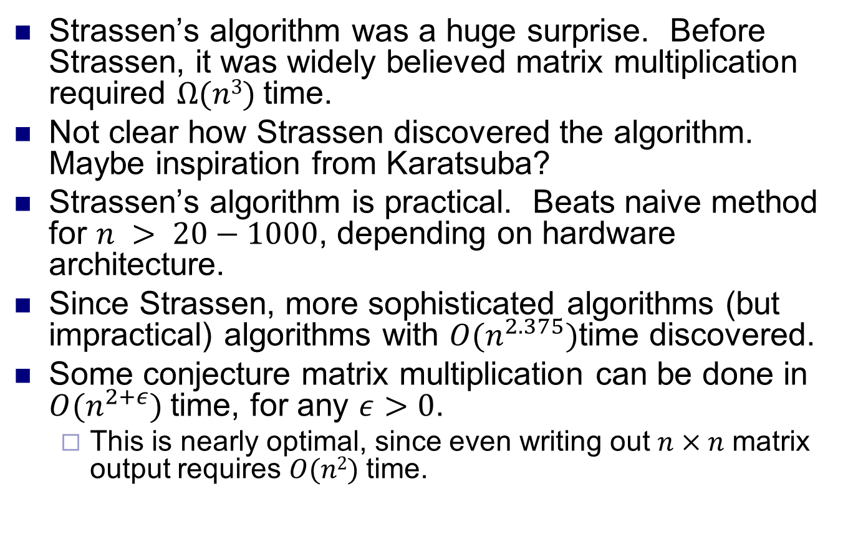
More about matrix multiplication
Strassen’s algorithm was a huge surprise. Before Strassen, it was widely believed matrix multiplication required $Ω(n3)$time.
Not clear how Strassen discovered the algorithm. Maybe inspiration from Karatsuba?
Strassen’s algorithm is practical. Beats naive method for $n > 20−1000$, depending on hardware architecture.
Since Strassen, more sophisticated algorithms (but impractical) algorithms with $O(n^{2.375})$time discovered.
Some conjecture matrix multiplication can be done in $O(n^{2+ε})$time, for any $ε>0$.
This is nearly optimal, since even writing out $n×n$ matrix output requires $O(n2)$time.

